Slide 1
Delegation of Areas of Responsibilities (AORs)
Stephen Chick
Notes:
hello im stephen and this it the delegations of areas of responsibilities project

Slide 2
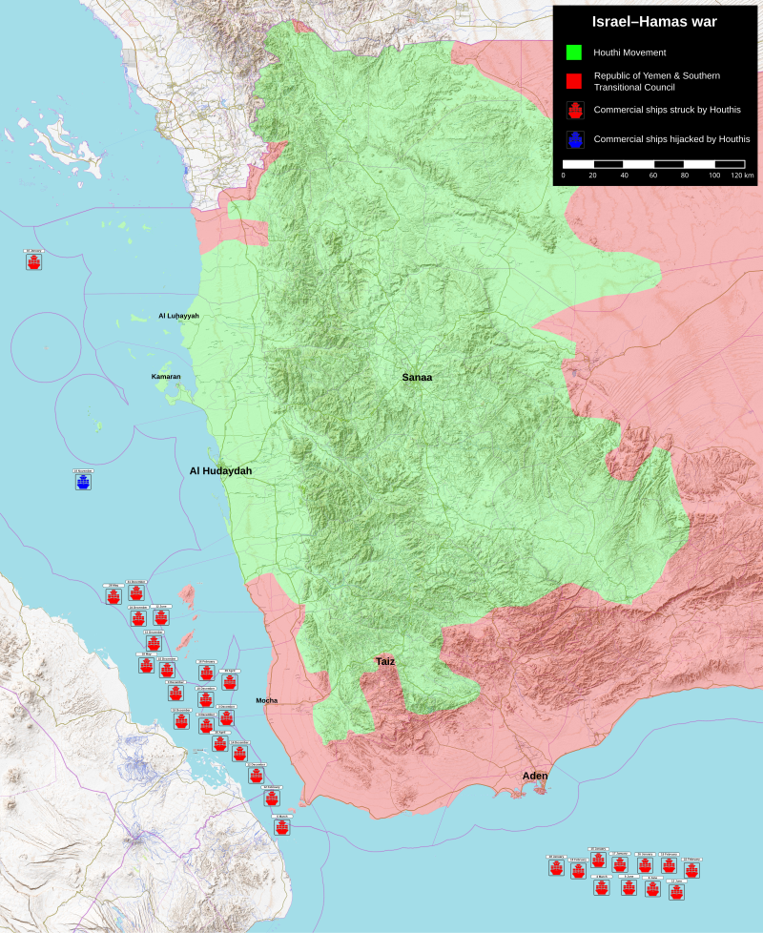
Problem
Crises around the world
Military operators need support
Proper responses to events can save lives
Also financially beneficial
Current events: Rea Sea Crisis (Houthis)
Red Sea Conflict Map, Source: Wikipedia
Notes:
so the problem is there is crises around the world
you see in the news that there are terrorist organizations such as the houthis
attacking ships in the red sea
and we believe that if we can help military personel to respond to these events
we can save lives as well as mitigating financial losses

Slide 3
Solution
Tool designed for operators and organizations
User defined regions to meet needs
Delegation of Areas of Responsibilities
Make management easier: promotes efficient action of parties involved
Notes:
the solution we're providing is an app that allow administrators to delegate areas of res.
to employees, which are a collection of regions or areas of interest.
we also have a neat feature that allows the creation of user defined regions, so operators
can make custom regions to adapt in the situation they're in.
All in all this app seeks to make management easier and promotes efficient response to events

Slide 4

Technology Used: Node.js
Comes with NPM (Node Package Manager)
Great for collaboration and installing libraries
Javascript Support
Extensive community and environment
Find community-made packages
Notes:
some technology used is node js <...>

Slide 5

Technology Used: Express
For backend development
Dynamic route handling
Parameters
Good middleware support
RESTful API Support
Notes:
we also have express for the backend development <...>

Slide 6

Technology Used: React
Paramount to frontend development
Component based architecture
Separation of functionality
High performance
Big community
Lots of community libraries out there
Notes:
and we plan on using react for the frontend <...>

Slide 7
Technology Used: MongoDB
REGION:
regionName: str
boundingBox: [[],[]]
orgId: ORGANIZATION
USER:
username: str
name: str
password: str
role: str enum
orgId: ORGANIZATION
ORGANIZATION:
name: str
AOR:
aorName: str
regionList: REGION[]
userList: USER[]
orgId: ORGANIZATION
Notes:
and last but not least we have mongodb which is a nosql database
it takes the modern object oriented approach to database design
and it supports simple but powerful pipelined aggregations
here are the mongoose schemas used for the app <...>

Slide 8
Biggest Challenge
Package version control
Learning curve of each stack component from M.E.R.N.
MongoDB: learning its functionalities
React: apply S.O.L.I.D. programming principles
React: full of frontend bugs
Notes:
the biggest challenges are version control. some features of certain packages
end up becoming deprecated and it can be difficult to figure out what is the new
way to use the package components.
and another big hurdle is the learning curve for each of these stack components.
for example mongo is a very powerful database framework and when developing
we end up overcomplicating a lot of the aggregation pipelines

Slide 9
Biggest Highlight
Fully working database design
Supports fast lookups
Easy to use API for frontend development
Notes:
the biggest highlight is a working database design which supports fast lookups
as well as a robust and easy to use backend API for frontend integration

Slide 10
Future Work
Making the REACT Server
Interactive map
Notification system
Improve backend operations
User information is insecure
Improving backend admin controls
Limiting account creation to Admins
Adding more customization for users
Notes:
for future work we are looking into making the react server which includes a map
that can interact with our api. we also plan on adding a notification system because
currently, admins can only add employees to AORs directly.
The backend api is robust and working but we also want to improve it more.
for example, the user information being passed around isnt very secure and we also
want to add more customization for users.

Slide 11
Repositories
https://github.com/aphitorite/CSC3916_Project_API
Notes:
and this is the repository for the backend api and now i will show a demo of the product

